Slide 1

Introduction To Web
Web development

Slide 2


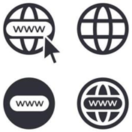

What is W.W.W
The World Wide Web (WWW), commonly known as the Web, is an information system where documents and other web resources are identified by Uniform Resource Locators(URL) or Search Engines, which may be interlinked by hypertext, and are accessible over the internet through the Web Browser.
The Web, is a global information infrastructure. A universal library and a collection of web server.

Slide 3
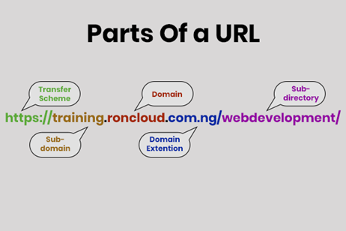
Uniform Resource Locator (URL)
These are words of patterns, use to refers to website. In other words, they are called domain names.
Examples of Uniform Resource Locator(URL) are
www.sitename.com
https//:www.example.com
http//:www.newsite.ng
www.blog.sitename.co.uk
www.example.co.za/contact.html

Slide 4

Search Engine
These are tools on the web used to locate searched keywords or phrases.
Examples of Search Engine are
Google
Bing
Yahoo!
Baidu
DuckDuckGo
Yandex
Ask.com
Etc.

Slide 5
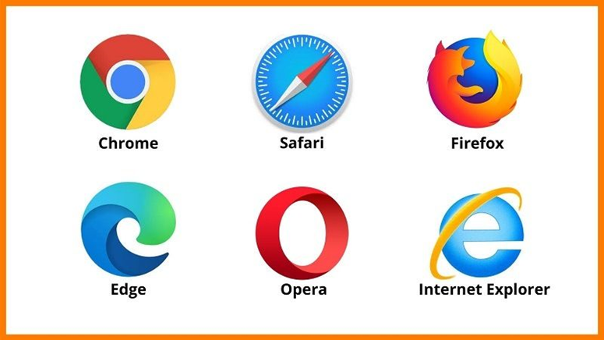
Web Browser
These are tools or applications, used for accessing web resources. The purpose of a web browser is to read web resources and display them
Examples of Web Browsers are
Internet Explorer.
Google Chrome.
Mozilla Firefox.
Safari.
Opera.
Etc.

Slide 6
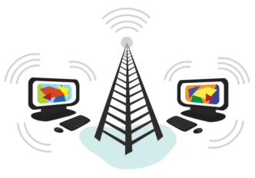

Internet
The Internet serves as the means of communications of multiple computers including clients and servers globally.

Slide 7
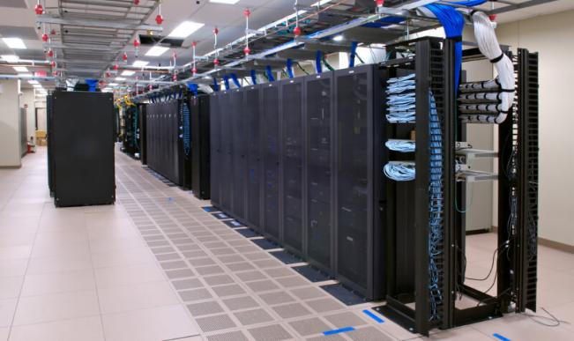

Web Server
The Web Server, is a server software or device used for storing web resources which can be accessible by users via the internet using a web browser.
The primary function of a web server is to store, process and deliver web resources to clients. The communication between clients and server takes place using the Hypertext Transfer Protocol(HTTP).

Slide 8

Web Resources
These are files and documents that are accessible on the web.
Examples of Web Resources are
Web pages
Images
Documents
Vidéos
Audio
Etc.

Slide 9

Tools used in creating web resources are
HTML CSS JAVASCRIPT PHP MySQL Etc.

Slide 10
Introduction To HTML
Web page structure

Slide 11
What is HTML
HTML is a markup language that defines the structure of web documents (web pages).
HTML stands for Hyper Text Markup Language.
HTML consists of a series of elements, which you use to enclose, or wrap, different parts of the content to make it appear a certain way, or act a certain way. The enclosing tags can make a word or image hyperlink to somewhere else, can italicize words, can make the font bigger or smaller, and so on.
Each HTML tags describes different document content

Slide 12
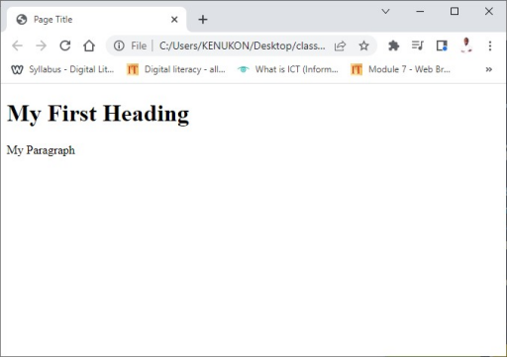
Example
<!DOCTYPE html>
<html>
<head>
<title>Page Title</title>
</head>
<body>
<h1>My First Heading</h1>
<p>My Paragraph</p>
</body>
</html>

Slide 13
Example Explained
<!DOCTYPE html>
<html>
<head>
<title>Page Title</title>
</head>
<body>
<h1>My First Heading</h1>
<p>My Paragraph</p>
</body>
</html>
The DOCTYPE declaration defines the document type to be HTML.
The text between <html> and </html> describes an HTML document.
The text between <head> and </head> provides information about the document.
The text between <title> and </title> provides title for the document.
The text between <body> and </body> describes the visible page content.
The text between <h1> and </h1> describes a heading.
The text between <p> and </p> describes a paragraph.

Slide 14
HTML Tags
HTML tags are keywords (tag names) surrounded by angle brackets: <tagname>content</tagname>
HTML tags normally come in pairs like <p> and </p>.
The first tag <p> in a pair is the start tag, the second tag </p> is the end tag.
The end tag is written like the start tag, but with a slash before the tag name.
The start tag is often called the opening tag.
The end tag is often called the closing tag.

Slide 15
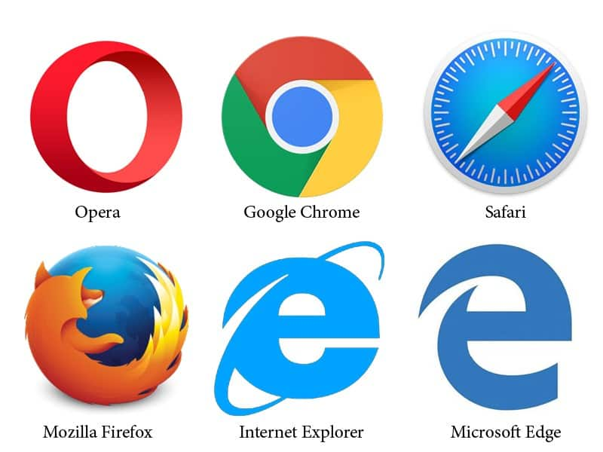
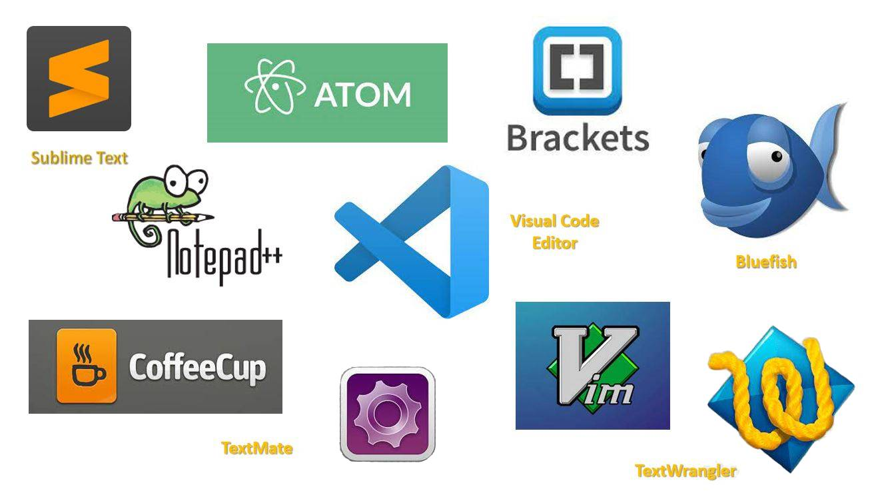
Tools used in creating and displaying HTML files are
Code editors
Web browser

Slide 16
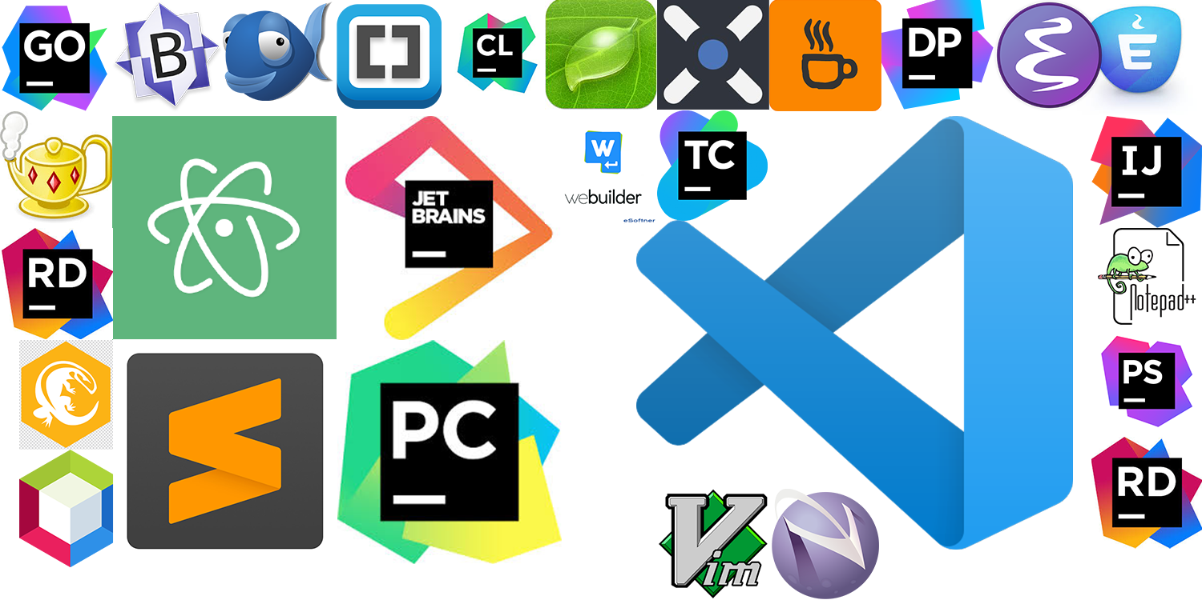
Code Editors
Code Editors are computer programs or applications used in creating and editing programming file and documents.
There are two types of Editors
Plain Text Editors
Integrated Development Environment (IDE)

Slide 17
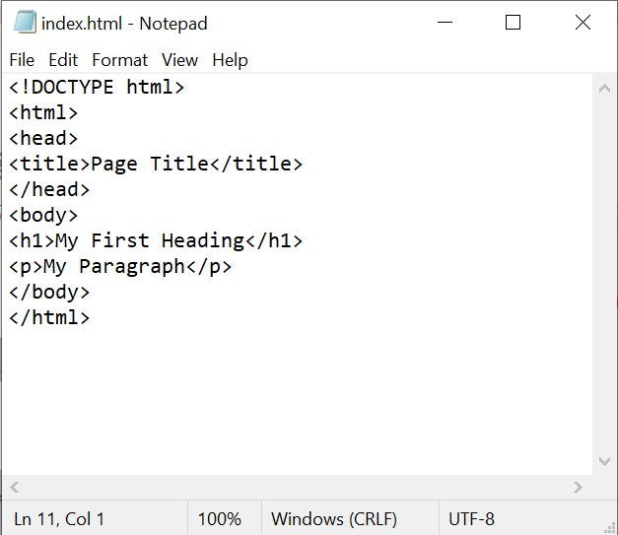
Plain Text Editors
These are editors that edit plain text. Most of these plain text editors are embedded in operating system(OS) installed in computers.
Examples Of Plain Text Editors
Notepad
Text Edits
Text Mate
Etcs

Slide 18
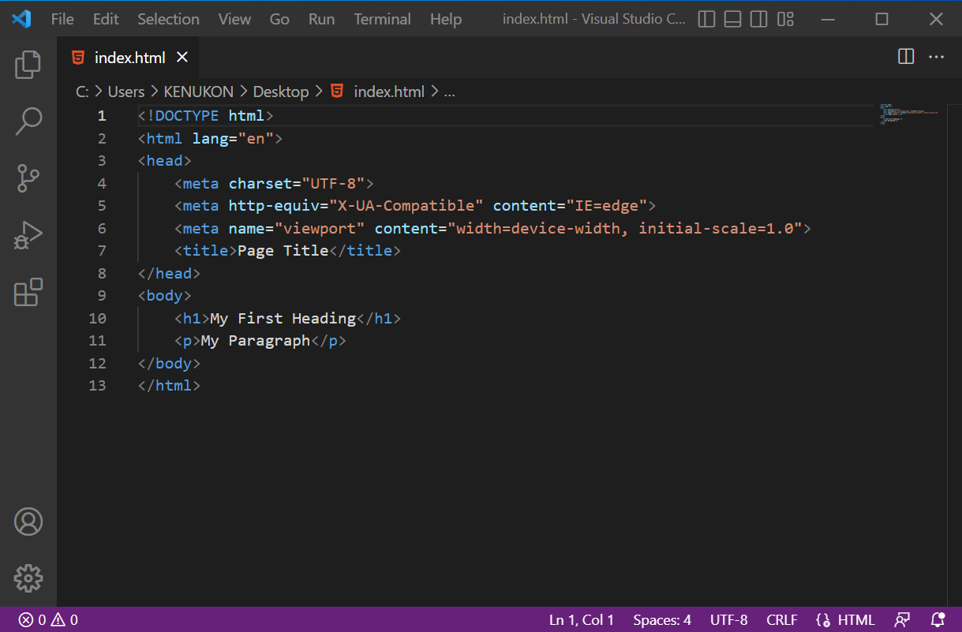
Integrated Development Environment (IDE)
These are editors that has graphical user interface(GUI), which enable users/programmers to reduce coding, has built-in automation tools and helps to debug easily.
Examples Of IDE Editors
Microsoft Visual Studio Code
Sublime Text
PyCharm
Android Studio
Adobe Dreamweaver
Etc.

Slide 19
Code Editors
Stated in the example above, those code can be written using any Editor either plain text editor or IDE.
To differentiate the type of program your writing, you have to save the file with an extension of “.html” or “.htm” for HTML files. Otherwise, it will be saved and treated as the default extension of the editor, which might not be visible via the web browser.
Examples
Index.html contactus.html
about_us.htm login.htm
Etc.

Slide 20
Web Browser
As said earlier, the purpose of web browser is to read web resources (like HTML) and display them.
The browser does not display the HTML tags, but uses them to determine how to display the document.
Examples of Web Browsers are
Internet Explorer.
Google Chrome.
Mozilla Firefox.
Safari.
Opera.
Etc.

Slide 21
Introduction To CSS
Web page STYLING

Slide 22
What is CSS
CSS is a stylesheet language that describes the presentation and styling of an HTML document.
CSS stands for Cascading Style Sheets
CSS describes how HTML elements are to be displayed on screen, paper or in other devices
CSS saves a lot of works, it can control the layout of multiple web pages all at once

Slide 23
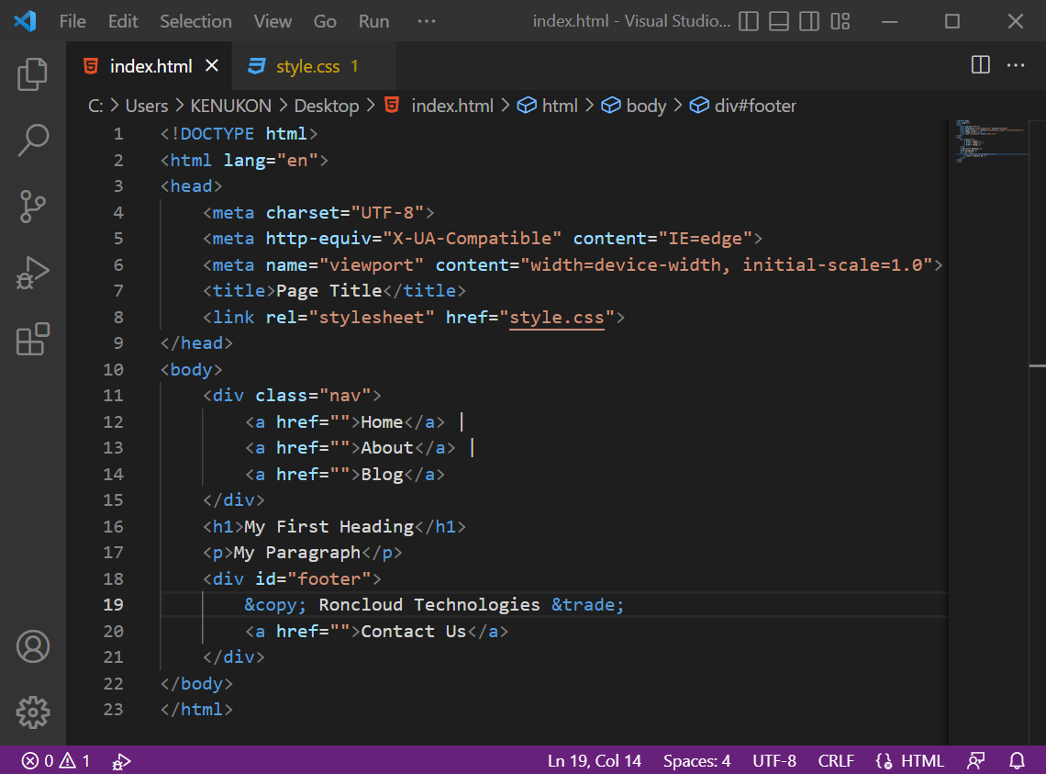
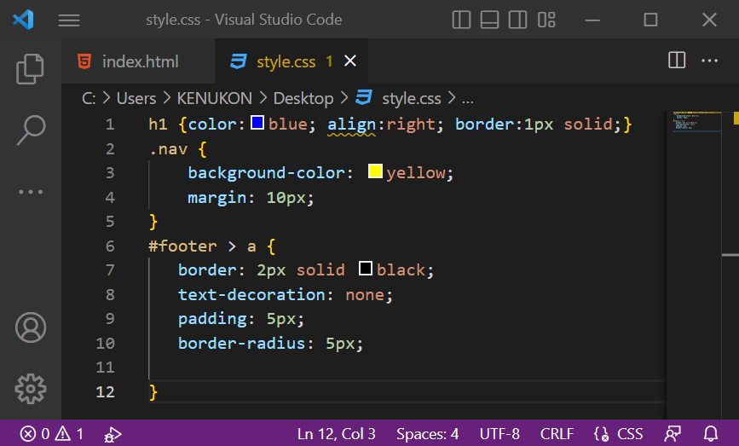
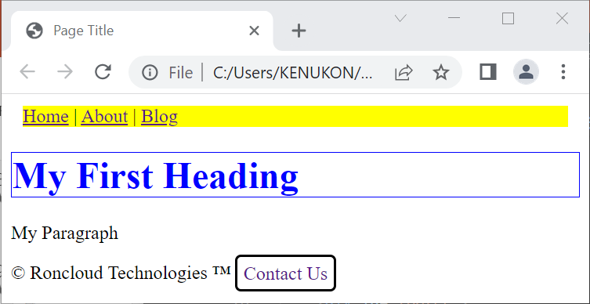
Example

Slide 24
Example
The “h1”, “.nav”, “#footer>a” are known as selector. Which refers to the element in an HTML file or documents.
Every other thing between the curly bracket “{“ and “}” are known as declarations. Which refers to the effect that will take place on the selectors been mentioned.
The word(s) before the colon “:” in the declarations are known as property, and the one(s) after the colon “:” are known as the value.
The selector(s) points to the HTML elements you want to style.
The declaration block contains one or more declaration(s) separated by semicolon(s).
Each declaration includes a CSS property name and a value, separated by a colon.
A CSS declaration always ends with a semicolon “;” and declaration blocks are surrounded by curly braces.

Slide 25
Assessment
What is the difference between the web and the internet?
What is the difference between uniform resource locator(URL) and search engine?
Explain a Mark-up language.
Explain a Style-sheet language.

Slide 26
<h1>Thank You !</h1>
Thank You !

Slide 27

THE BUILDING BLOCK OF WEBSITES

Slide 28
What is HTML
As said earlier, HTML is a markup language for describing web documents (web pages).
HTML stands for Hyper Text Markup Language.
A Markup language is a set of markup tags.
HTML documents are described by HTML tags.
Each HTML tags describes different document content.
HTML are used to create web page.
We have two types of web pages.
Static web page/website
Dynamic web page/website

Slide 29
Static Web Page/Website
As said earlier, HTML is a markup language for describing web documents (web pages).
HTML stands for Hyper Text Markup Language.
A Markup language is a set of markup tags.
HTML documents are described by HTML tags.
Each HTML tags describes different document content.
HTML are used to create web page.
We have two types of web pages or websites.
Static web page/website
Dynamic web page/website

